Slide 1
Digital Portfolio
STUDENT NAME: Sankari. R
REGISTER NO AND NMID: 24131061802522071 and autanm106106cs214047
DEPARTMENT: Computer Science
COLLEGE: COLLEGE/ UNIVERSITY Shree Raghavendra Arts & Science College / Annamalai university

Slide 2
PROJECT TITLE
DIGITAL PORTFOLIO:
This project is a simple online portfolio for Sankari. R. The website introduces Sankari, shows her skills (like Python, HTML, CSS, JavaScript, Java, C++), displays her certificates, and mentions her interests in sports such as badminton and kho-kho.
KEY SECTION:
1. Introduction and CV download
2. About Me (education and interests)
3. Skills displayed with icons
4. Certificates with details
5. Sports interests
6. Contact information (GitHub,LinkedIn,Email)
This portfolio is useful to share her profile, achievements, and contact details with others in a modern and organized way.

Slide 3


AGENDA
Problem Statement
Project Overview
End Users
Tools and Technologies
Portfolio design and Layout
Features and Functionality
Results and Screenshots
Conclusion
Github Link
3/21/2024 Annual Review

Slide 4

PROBLEM STATEMENT
⭐Students often struggle to present their skills, achievements, and projects in a professional manner.
⭐Traditional resumes are static and lack interactivity.
⭐A personal portfolio-website helps in showcasing technical skills, certificates, and extracurricular activities dynamically, increasing opportunities for internships and jobs.

Slide 5

PROJECT OVERVIEW
⭐This project is a personal portfolio website developed for Sankari.R.
⭐It highlights education, skills, certificates, extra curricular achievements, and contact information in an interactive and visually appealing design.
⭐The portfolio is fully responsive and deployed on GitHub Pages for public access.

Slide 6

WHO ARE THE END USERS?
Recruiters → To evaluate skills, certificates, and academic achievements. Faculty/College evaluators → For project assessment and showcasing student achievements. Peers and collaborators → To connect and collaborate on projects. General audience → To know about Sankari's journey and capabilities.

Slide 7

TOOLS AND TECHNIQUES
Frontend Framework: React.js Styling: CSS, animations Other Libraries: react-icons, typed.js, AOS animations Version Control: Git & GitHub Deployment: GitHub Pages Design Tools: Canva / Figma for layout inspiration

Slide 8
POTFOLIO DESIGN AND LAYOUT
The portfolio follows a modern single-page scrolling layout with sections:
Home (Hero)-> Animated introduction with glowing effects and profile photo. About->Personal introduction, education details, and career goal. Skills-> Display of technical skills with logos and animations. Certificates-> Achievements displayed. Sports->Section highlighting extracurricular activities with images. Contact->Direct links to email, GitHub, and LinkedIn. Footer-> Clean copyright and quick links.
8

Slide 9
FEATURES AND FUNCTIONALITY
1. Animated typing effect for introduction. 2. Floating glowing decorations for modern design. 3. Profile photo with animated circular border. 4. Certificates displayed as cards with pop-up view and download option. 5. Sports achievements showcased with images and descriptions. 6. Smooth scroll navigation with navbar. 7. Fully responsive (works on desktop and mobile).

Slide 10
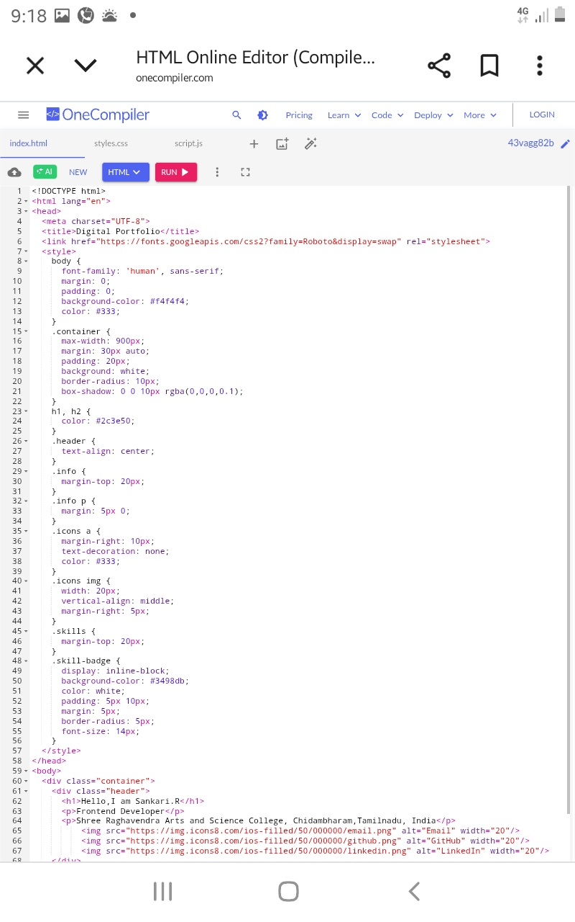
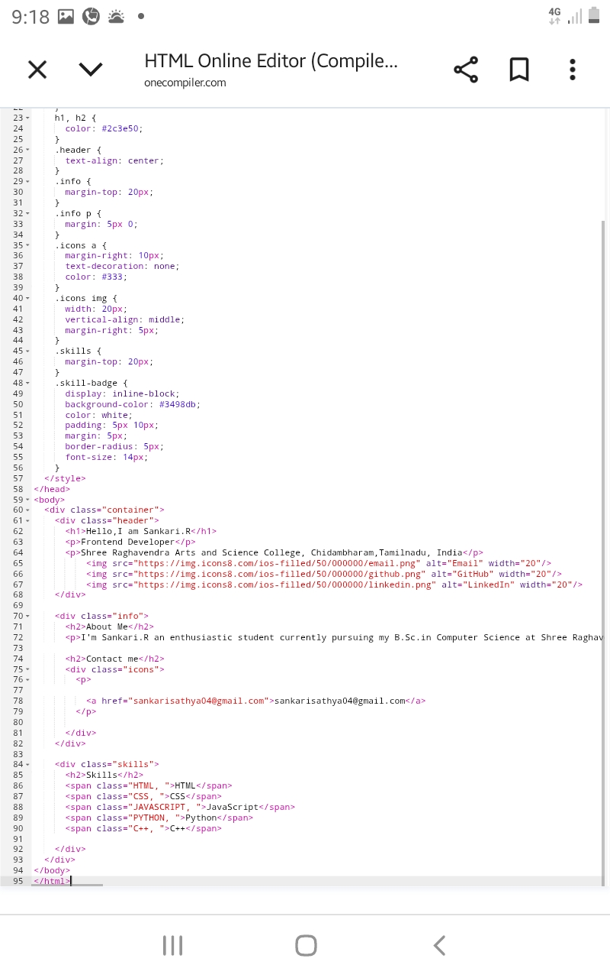

RESULTS AND SCREENSHOTS(HTML)
3/21/2024 Annual Review
10

Slide 11
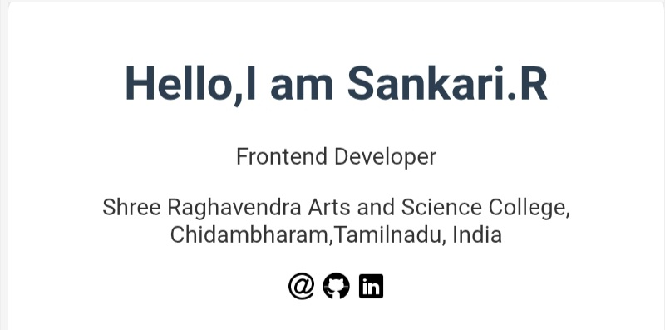
RESULTS AND SCREENSHOTS

Slide 12
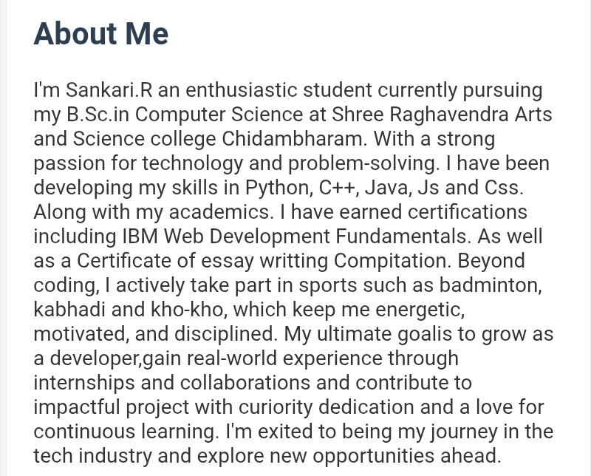
RESULTS AND SCREENSHOTS

Slide 13
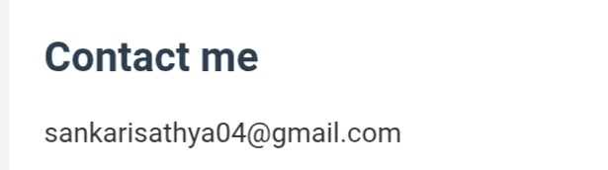
RESULTS AND SCREENSHOTS

Slide 14
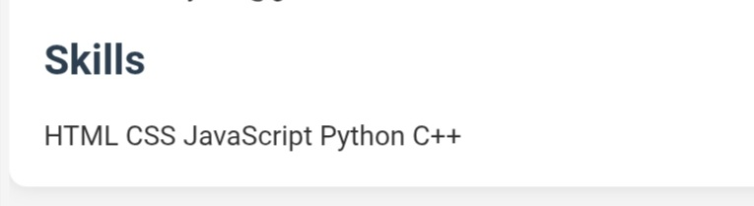
RESULTS AND SCREENSHOTS

Slide 15
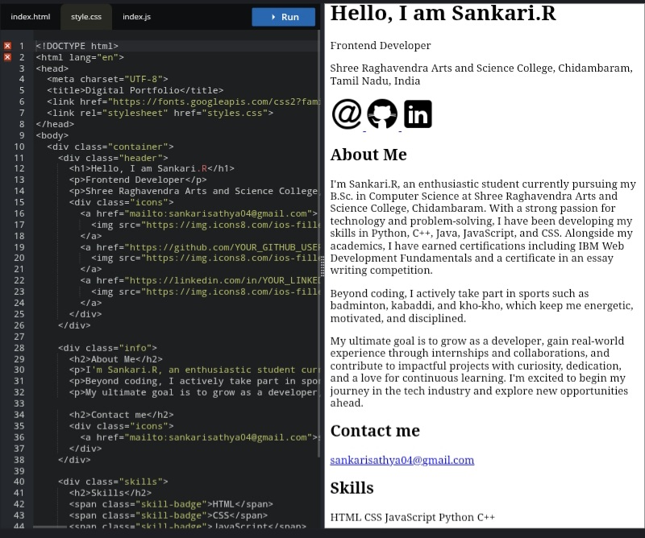
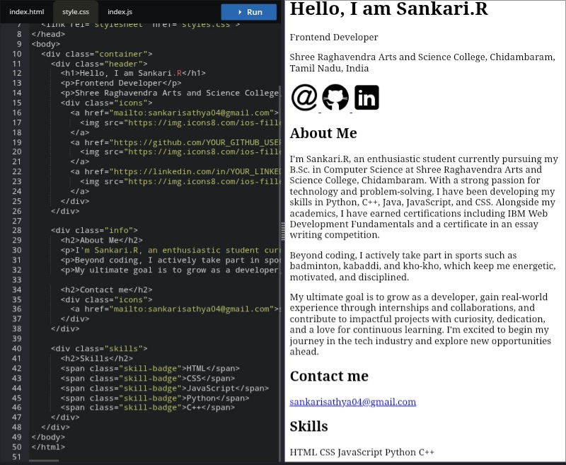
RESULTS AND SCREENSHOTS(CSS)

Slide 16
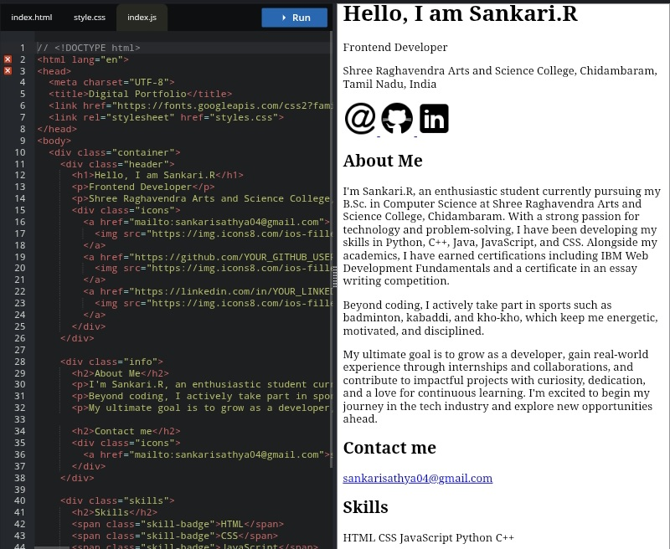
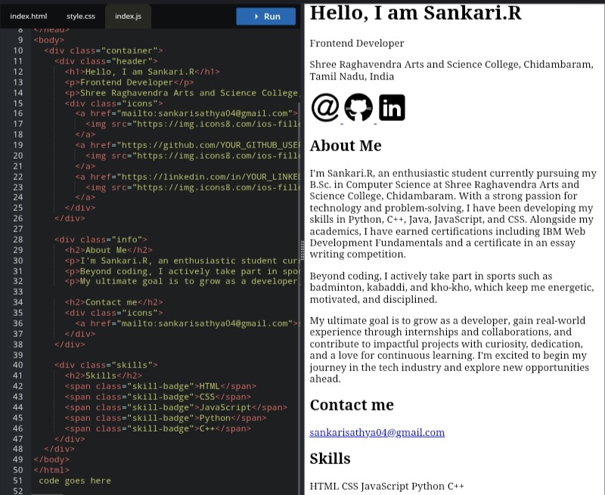
RESULTS AND SCREENSHOTS(JS)

Slide 17
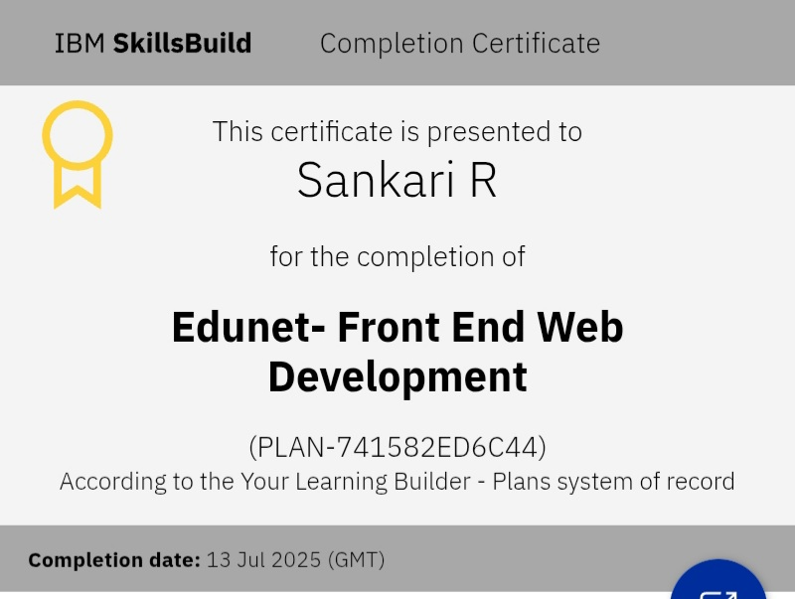
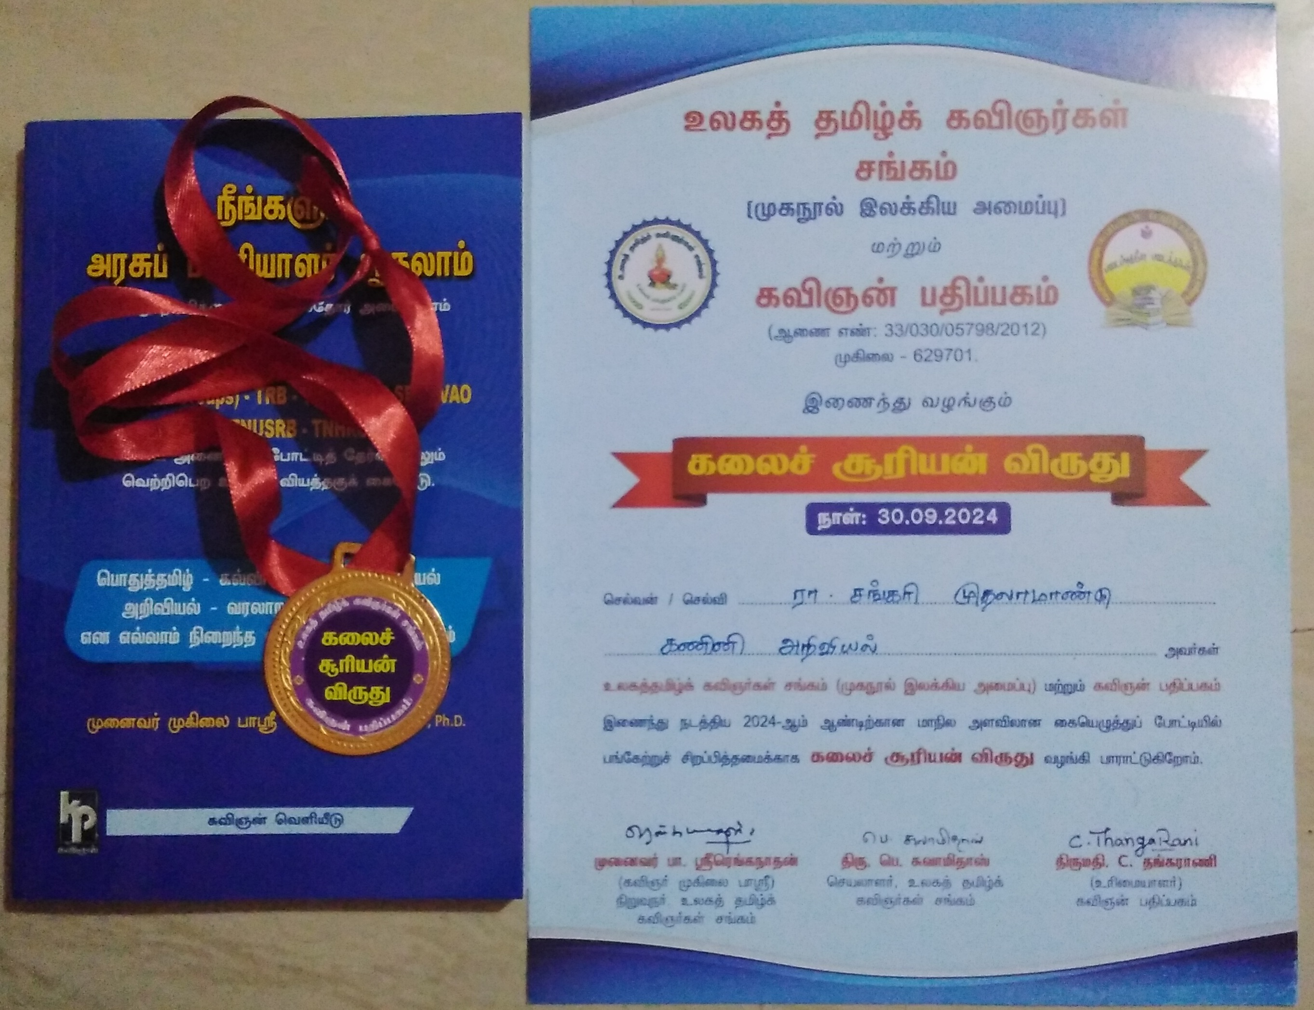
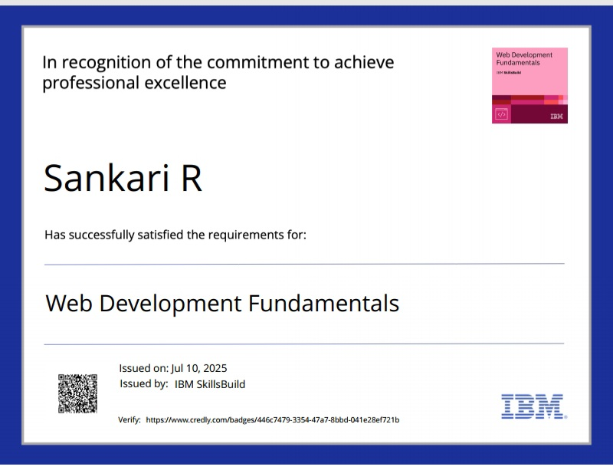
CERTIFICATES

Slide 18
CONCLUSION
The project demonstrates how a student can transform a static resume into a dynamic portfolio website. It serves as a platform to showcase technical skills, achievements, and extracurricular activities in a modern, interactive format. This portfolio will help Sankari in her academic growth, internships, and job opportunities.
18

